Slide 1











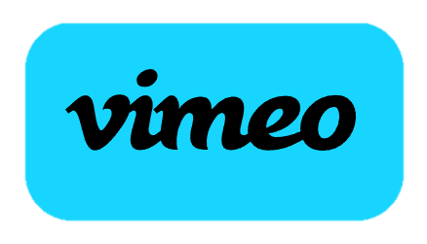

Slide 2




A Social Media Joint-Brand Strategy to Support Government…

Slide 3



Slide 4





Slide 5


Slide 6


Slide 7
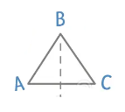




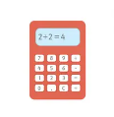







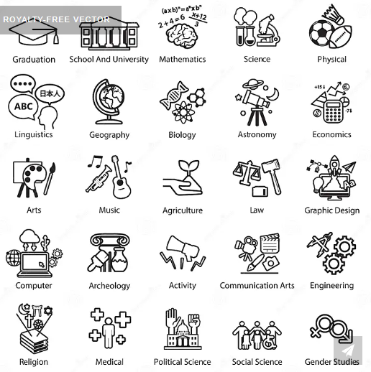
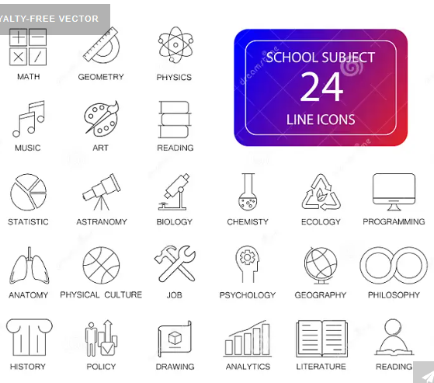



Slide 8

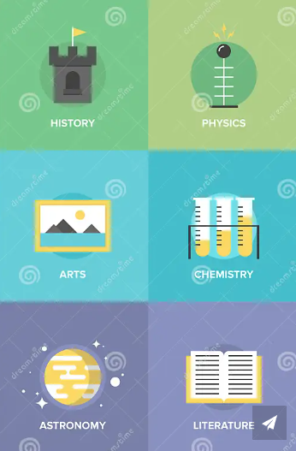

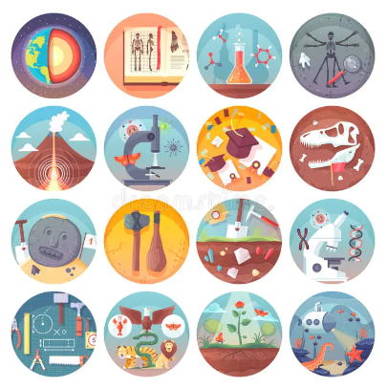

Slide 9
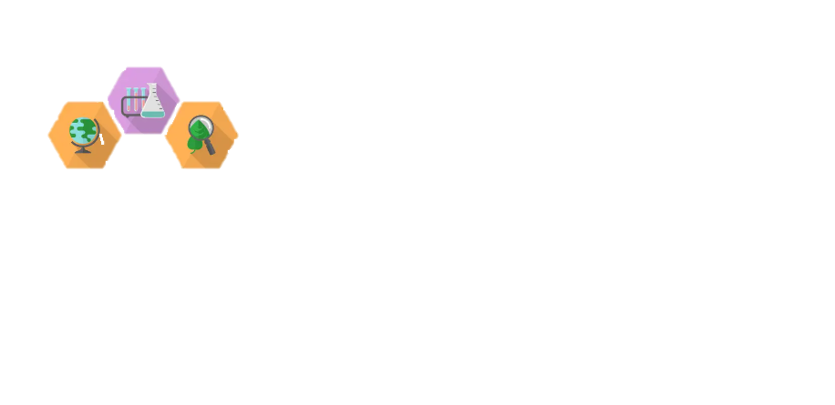
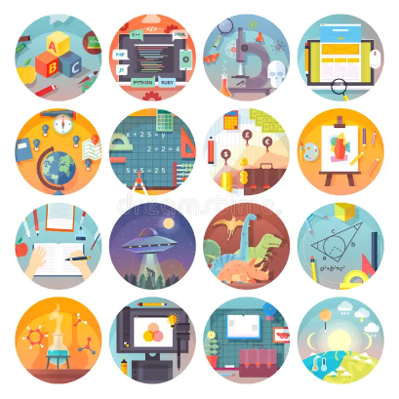

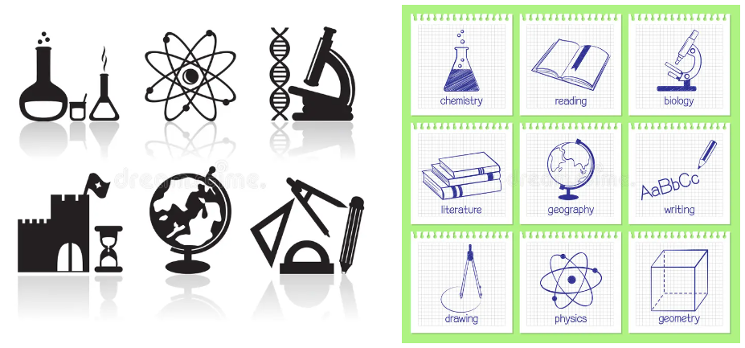
Digital Logic

Slide 10


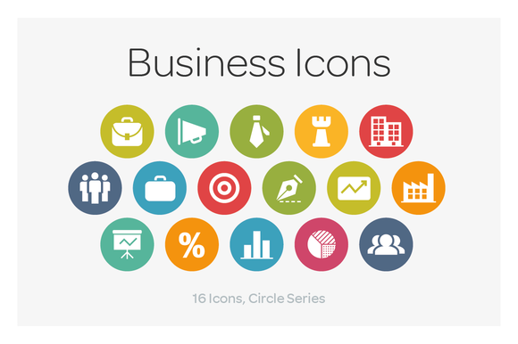



Slide 11


Creating real-world relevant content as packages of various sizes.
Can be seen as lesson extensions.
Schools partner with various Hybrid-Learning networks…
Among those agreements will be currently in use partnerships, which schools contract lesson plan arrangements with.
This allows for the flexibility in the market… but we also need to think of overall security design and how the lasting layers of people’s data are managed.
So we’re best off having a joint-architecture design… or by considering some components of every system to be of this more advanced platform… which can monitor all code ran in production, generate test data… etc… to protect people’s security as we should in the modern age.
It’s also important we have these levels of discussion with the public systemically.
The public should see it as a way we ensure (and they can ensure) they are being involved in the full conversation… rather than view it as being designed to limit their opinion’s relevance.

Slide 12


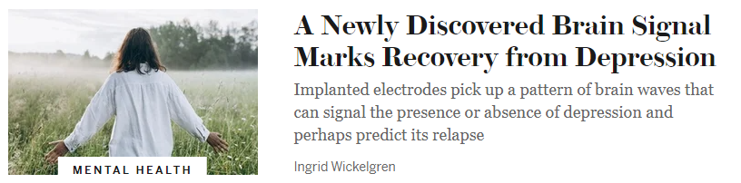


Slide 13



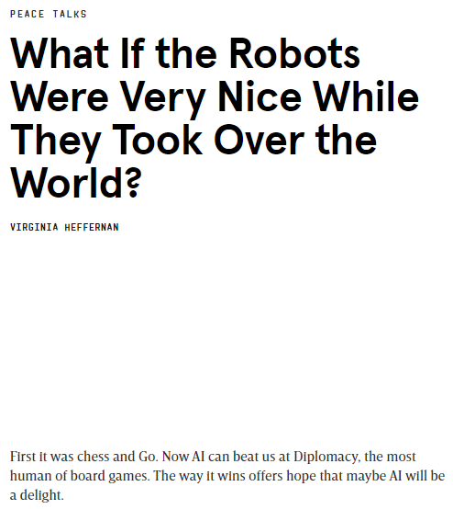

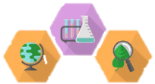

In practice, this system will help all social medias to leverage an approach which allows people to pass knowledge hand-offs… or when an individual brings a topic up online that another user doesn’t quite understand, or it seems they are confused… you present this sort of linked Content… and eventually create the linking which allows branches of topics to be zeroed in on specific levels of understanding.
This will help us as we consider various levels of approaches…
Again, being that this page is meant to be focused on project management sourcing for the government, specific modifications of infrastructure… and even just proving how many ways we’re trying to give people chances to know where we’re at, and thus be involved… that increase buy-in.
Digital Logic
Physical
Encryption
Google’s Titan-M Chip
Versatile Architectural Approach Which Extends Cyber Security Compartmentalization.
THIS FINAL LINE IS REALLY LOW.
Digital Logic
Physical
Encryption

Slide 14
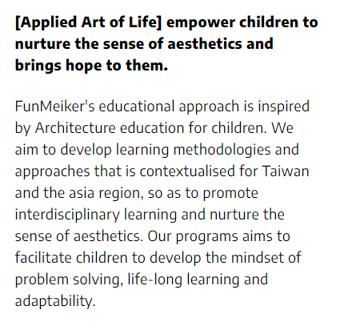
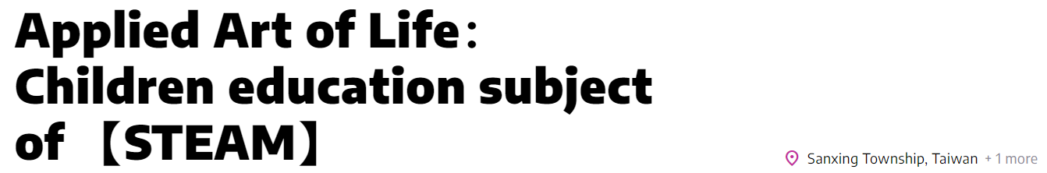

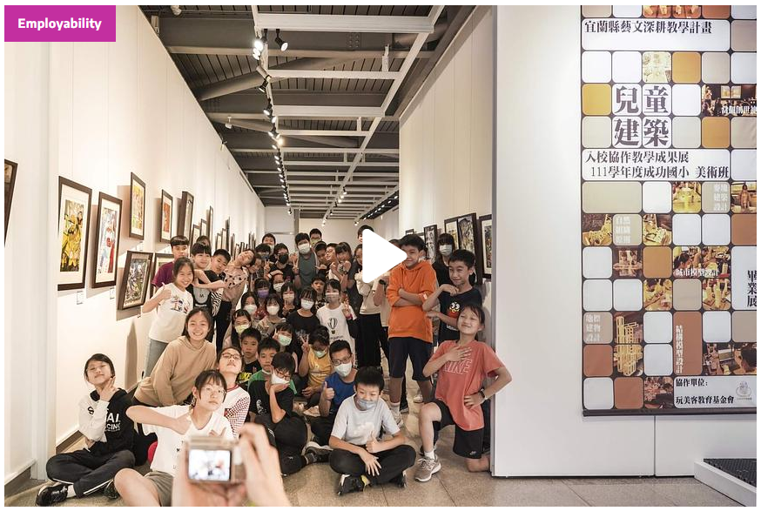
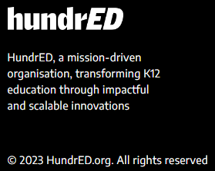
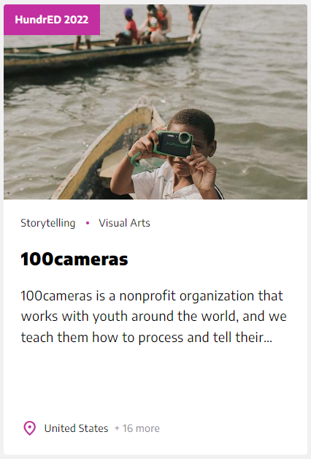
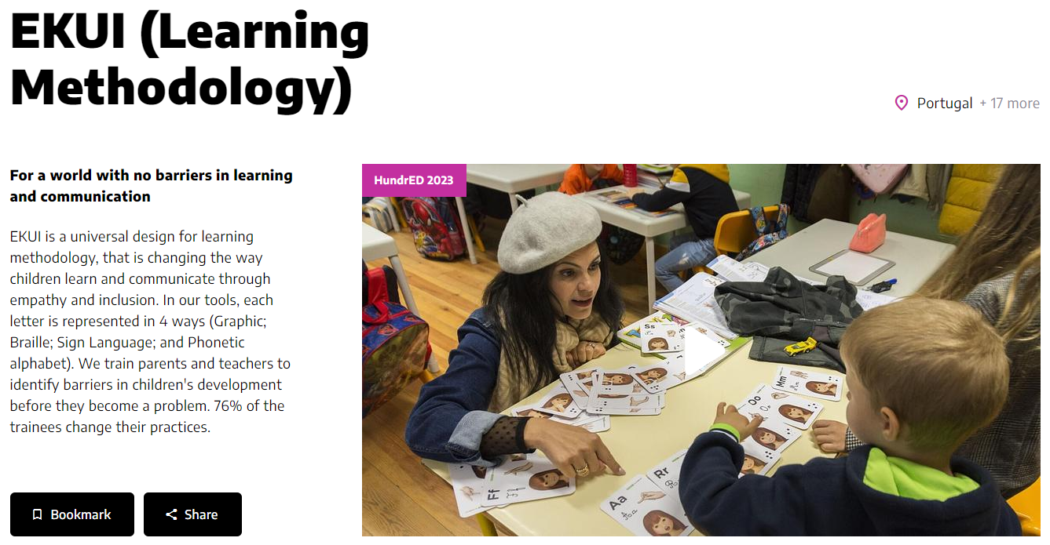

Slide 15

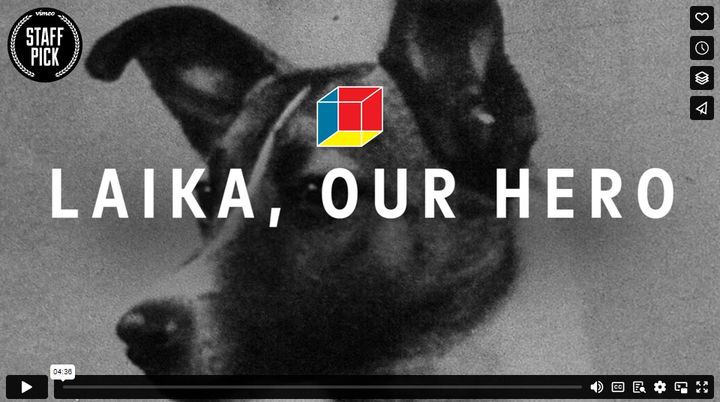

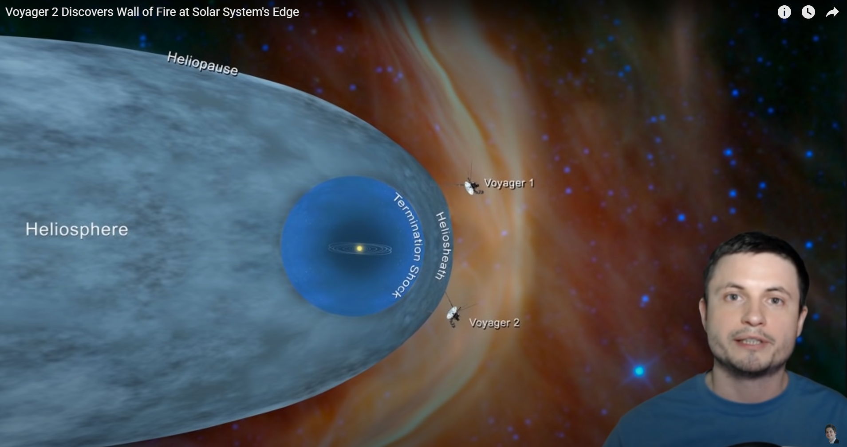

Sputnik-2 or: Laika, Our Hero
In 1957, a Soviet street dog named Laika launched into space aboard Sputnik-2 and became the first animal to orbit the Earth. This is her story.
https://vimeo.com/236428627
Sputnik-2 or: Laika, Our Hero
In 1957, a Soviet street dog named Laika launched into space aboard Sputnik-2 and became the first animal to orbit the Earth. This is her story.

Slide 16
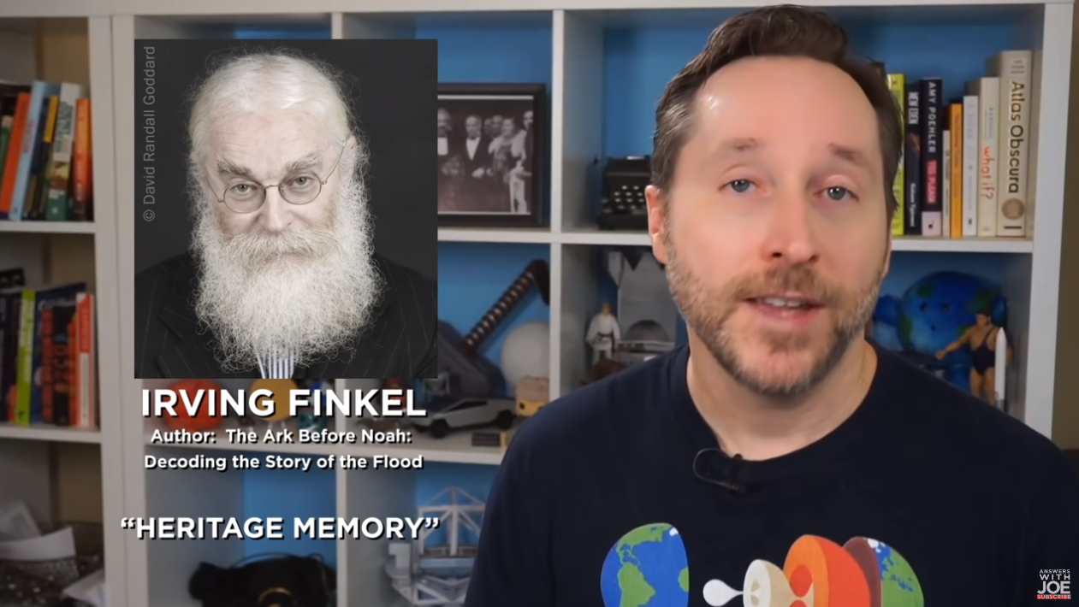

Sputnik-2 or: Laika, Our Hero
In 1957, a Soviet street dog named Laika launched into space aboard Sputnik-2 and became the first animal to orbit the Earth. This is her story.
https://vimeo.com/236428627
Sputnik-2 or: Laika, Our Hero
In 1957, a Soviet street dog named Laika launched into space aboard Sputnik-2 and became the first animal to orbit the Earth. This is her story.

Slide 17
Sputnik-2 or: Laika, Our Hero
In 1957, a Soviet street dog named Laika launched into space aboard Sputnik-2 and became the first animal to orbit the Earth. This is her story.
https://vimeo.com/236428627
Ancient Civilization Before Humans
Ancient Aliens Reference

Slide 18







Sputnik-2 or: Laika, Our Hero
In 1957, a Soviet street dog named Laika launched into space aboard Sputnik-2 and became the first animal to orbit the Earth. This is her story.
https://vimeo.com/236428627
Climate Change Research
Key current climate Data-Capture Systems Design.
Key analysis data > Suess Effect (CO2 isotope ratios)
Public-Facing Modeling Analysis Front-Ends with pre-set generated query results.
https://www.sciencedirect.com/science/article/abs/pii/0160412079900059#:~:text=The%20Suess%20Effect%20is%20a,the%20combustion%20of%20fossil%20fuels.

Slide 19




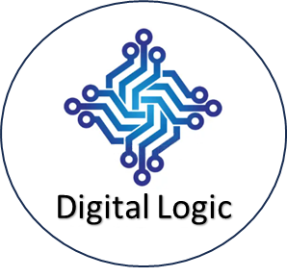
RSA Evolves
A Colorado based tech company has partnered with Strategic Pivot to investigate feasibility of building the Cyber Force network approach first outlined at the Saint Cloud, MN Library in 2019. The approach combines a Multi-Factor Auth expansion, with Physical Encryption Arch.
Khan Academy
Digital Logic
Physical Encryption
Quartus Randomization
RSA Evolves
A Colorado based tech company has partnered with Strategic Pivot to investigate feasibility of building the Cyber Force network approach first outlined at the Saint Cloud, MN Library in 2019. The approach combines a Multi-Factor Auth expansion, with Physical Encryption Arch.
University of MN
Digital Logic
Physical Encryption
Quartus Randomization

Slide 20









Slide 21
Article/Concept Title
Versatile
Digital Logic
Physical Encryption
Quartus Randomization
Article/Concept Title
Versatile
Quiz class (Multi-Topic/Single)
I don’t like this design as much… I like being able to hover over components of a topic and see what it relates to.

Slide 22




Google’s Titan-M Chip
Versatile Architectural Approach Which Extends Cyber Security Compartmentalization.
THIS FINAL LINE IS REALLY LOW.
Digital Logic
Physical
Encryption
Google’s Titan-M Chip
Goo
Versatile Architectural Approach Which Extends Cyber Security Compartmentalization.
THIS FINAL LINE IS REALLY LOW.
Versatile
Digital Logic
Physical
Encryption
Digital Logic
Physical
Encryption
Goo
Goo
Versatile
Versatile
Digital Logic
Physical
Encryption
Digital Logic
Physical
Encryption
Goo
Goo
Versatile
Versatile
Digital Logic
Physical
Encryption
Digital Logic
Physical
Encryption

Slide 23

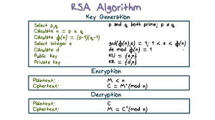
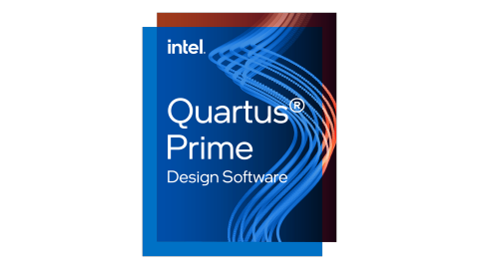


Slide 24

https://www.sciencedirect.com/science/article/abs/pii/0160412079900059#:~:text=The%20Suess%20Effect%20is%20a,the%20combustion%20of%20fossil%20fuels.

Slide 25
Standardization of Education Lesson/Presentation data-groupings for overall concept completion %.
Subject (Lesson-Plan) → Session (Lesson-Plan) → Topic → Concept
In this way… content systems can be built for marketing Topic/Concept Videos to be perfected for learning networks to partner with.

Slide 26
Google’s Titan-M Chip
Versatile Architectural Approach Which Extends Cyber Security Compartmentalization.
THIS FINAL LINE IS REALLY LOW.
Digital Logic
Physical
Encryption
Google’s Titan-M Chip
G
Versatile Architectural Approach Which Extends Cyber Security Compartmentalization.
THIS FINAL LINE IS REALLY LOW.
Versatile
Digital Logic
Physical
Encryption
Digital Logic
Physical
Encryption
G
G
Versatile
Versatile
Digital Logic
Physical
Encryption
Digital Logic
Physical
Encryption
G
G
Versatile
Versatile
Digital Logic
Physical
Encryption
Digital Logic
Physical
Encryption

Slide 27
Google’s Titan-M Chip
Versatile Architectural Approach Which Extends Cyber Security Compartmentalization.
THIS FINAL LINE IS REALLY LOW.
Digital Logic
Physical
Encryption
Google’s Titan-M Chip
Goo
Versatile Architectural Approach Which Extends Cyber Security Compartmentalization.
THIS FINAL LINE IS REALLY LOW.
Versatile
Digital Logic
Physical
Encryption
Digital Logic
Physical
Encryption
Goo
Goo
Versatile
Versatile
Digital Logic
Physical
Encryption
Digital Logic
Physical
Encryption
Goo
Goo
Versatile
Versatile
Digital Logic
Physical
Encryption
Digital Logic
Physical
Encryption

Slide 28
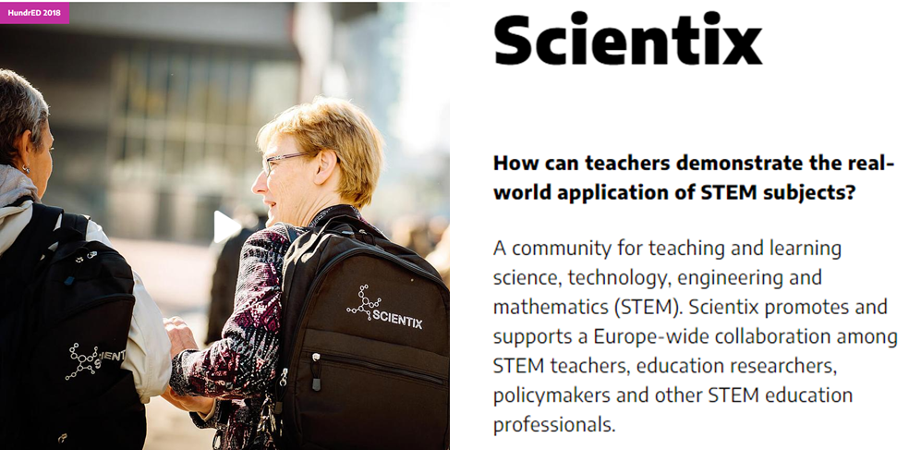
https://hundred.org/en/innovations
Ultimately… when it comes to integrated hybrid-learning solutions…
We’re looking for remotely accessible self-contained Learning Environments… which utilize qualified Identity-Product networks to enable more advanced features…
Such as incorporation of Digital Mental-Health Network Partnerships…
This might better be served by insurance networks tied to identity level features…
Useful to have joint-relationship here in product design in my opinion, largely for ensuring access. Now a parent’s insurance network… can route the child to the related current Mental-Health platform network.
The primary features to include in packaged learning platforms…
For every subject…
Weaving videos, with a by time-stamp insertion feature for specific Power-Point slides, Prezi-links, or other “enhanced video/question generation mediums”…
Ordering content sequentially… more advanced lesson plans may require milestones between points… this leads to conversation of API standardization for overall completion coverage between lesson networks.
Every Course can be composed of numerous Lesson-Plans… which are composed of Presentation/Review sessions…
These can cover a number of Subject/Topic designations…
Which then is how we log any/all specifically associated Q/A sets…
Customizations examples…
Weaving videos, with a by time-stamp insertion feature for specific Power-Point slides, Prezi-links, or other “enhanced video/question generation mediums”

Slide 29
Ultimately… when it comes to integrated hybrid-learning solutions… We’re looking for remotely accessible self-contained Learning Environments… which utilize qualified Identity-Product networks to enable more advanced features…
Such as incorporation of Digital Mental-Health Network Partnerships…
This might better be served by insurance networks tied to identity level features…
Useful to have joint-relationship here in product design in my opinion, largely for ensuring access. Now a parent’s insurance network… can route the child to the related current Mental-Health platform network.
Continuing on this concept… businesses are much more efficient, and can offer far more flexibility for their patients to pursue care tailored to their needs… if they build a back-end management strategy, with operational authority awarded based on sales and other results metrics.
Now many products can be protected by layered approaches to security… which enhances overall security, and allows the businesses to focus on furthering the quality of the products/services… by merging their approach… they optimize cost fastest… and this allows them to develop standardized architectural approaches more securely… because you’ve enabled additional compartmentalization while optimizing your costs.
You want to make groups of industry terminology, relevant statistical models, and report elements to be built with an object-oriented design… such that across the medical industry… it’s easier to perfect the tools that save lives… as now we’ve developed an overall approach to how we archive records… that allows them to be pulled into different types of reports specific to provide the perfect contextual overview for the suspected condition, or treatment plan.
It’s important to protect that flexibility in the market… as in this particular example… adopting that practice enhances your statistical ability to produce the tools that allow professionals under pressure to save more lives. Strategic Pivot aims to involve more people with passion in developing new approaches to reach to do so.

Slide 30
The primary features to include in packaged learning platforms…
For every subject…
Weaving videos, with a by time-stamp insertion feature for specific Power-Point slides, Prezi-links, or other “enhanced video/question generation medium”…
Ordering content sequentially… more advanced lesson plans may require milestones between points… this leads to conversation of API standardization for overall completion coverage between lesson networks.
Every Course can be composed of numerous Lesson-Plans… which are composed of Presentation/Review sessions…
These can cover a number of Subject/Topic designations…
Which then is how we log any/all specifically associated Q/A sets…
There’s a huge market for methods of making learning more interactive online in and of itself.
Strategic Pivot is a methodology for relevant scoping to current events… it’s a great extension to feature content through and zero-in discussion through various social medias on specific relevant current events of geo-political subjects.
Classrooms could be zeroing-in on how we build the network of data-streams monitoring global warming & climate change. We could be talking about opportunities to get more, better data through the right partnerships and network extensions.

Slide 31
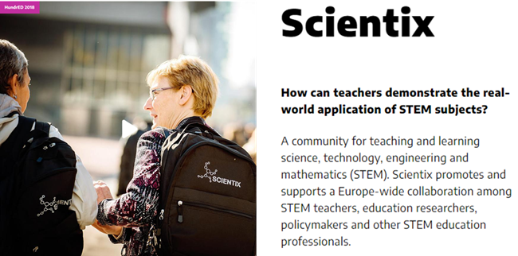
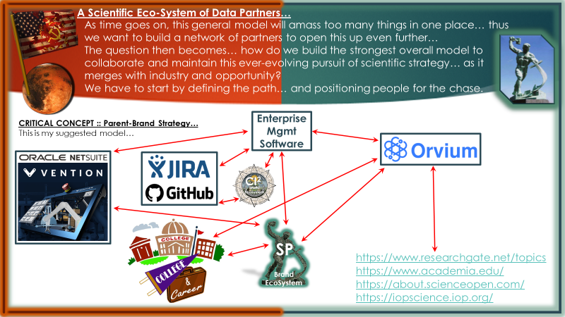
Perfecting a Hybrid-Learning Eco-System will be a true equivalent of the public education system… with access to all networks in the market, but in reality offering more profit opportunities for those creating new, relevant content… and increasing the access to resources for various education networks.

Slide 32
Perfecting a Hybrid-Learning Eco-System will be a true equivalent of the public education system… with access to all networks in the market, but in reality offering more profit opportunities for those creating new, relevant content… and increasing the access to resources for various education networks.
I picture this at the point one day where this vast network knows it can position all of society for the chase… by setting some rel3evant priorities… and building the structure such that for each signed in identity in every learning network… by class, and age group… content is built to bridge the gap between that audience’s level… and the more advanced concepts.
I picture there being some way… whether we aim to have tablets in rotation for a given subject… and students only interact via web-enhanced content once a week in the classroom… or whatever the schedule…
With this overall network… you could see new relevant content aimed at bridging the gap between learning, and real-world, relevant to current goals/events examples of the skills being utilized.
With the right structure, relevant examples and alerts will populate relevant to network contract… And in some unique cases where businesses are impressed and see the advantage… they may sponsor access to specific new content and make it accessible through multiple networks, or publicly available.
A lot of interesting ways we can connect these networks and help people identify opportunities to build relevant content which helps our society move forward.

Slide 33
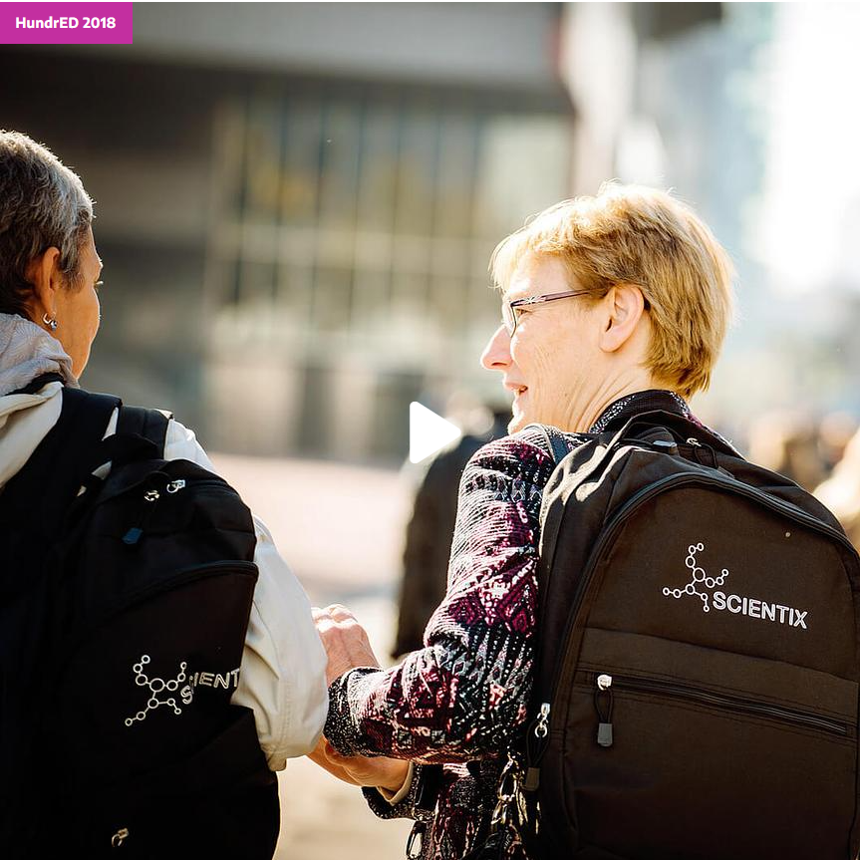
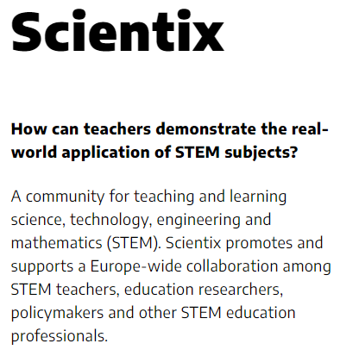


Slide 34
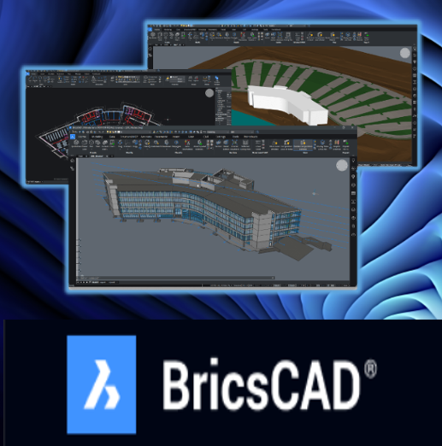


Slide 35
